Slide 1




NEXT GEN EMPLOYABILITY PROGRAM
Creating a future-ready workforce
Team Members
College Name
Student Name :Anonanciya Rose.M
Student ID :311121104007
Loyola-ICAM College of Engineering And Technology

Slide 2

CAPSTONE PROJECT SHOWCASE
Project Title
MUSIC WEB APPLICATION USING DJANGO FRAMEWORK
Abstract | Problem Statement | Project Overview | Proposed Solution | Technology Used | Modelling & Results | Conclusion

Slide 3
Abstract:
Our Django-based music web application delivers a seamless and personalized music streaming experience. Users can register, log in securely, and explore an extensive music catalog with ease. The application enables playlist creation, search functionality, and responsive design for optimal accessibility across devices.
With a user-friendly interface and intuitive navigation, users can discover new music, manage playlists, and enjoy their favorite tunes effortlessly. Built with Django's robust features, the application offers authentication, playlist management, and efficient search capabilities. It caters to music enthusiasts, providing them with a comprehensive platform to discover, organize, and enjoy music, anytime, anywhere.
The music web application developed using the Django framework is a comprehensive platform designed to provide users with an immersive and personalized music listening experience. Leveraging Django's powerful features and flexibility, the application offers a range of functionalities including user authentication, music browsing, playlist creation, search capabilities, and more.
Source :

Slide 4
Problem Statement:
Despite the abundance of music streaming services available, there is still a need for a customizable and user-centric platform tailored to the preferences of individual users. Existing platforms may lack certain features or fail to provide a seamless and intuitive user experience. The challenge is to develop a Django-based music web application that addresses these shortcomings by offering a comprehensive set of features including user authentication, playlist management, efficient search functionality, and responsive design.
The application should prioritize user experience and personalization, allowing users to explore, discover, and enjoy music in a seamless and engaging manner. Additionally, the platform should be scalable, adaptable, and capable of handling a large volume of users and music content while maintaining optimal performance.
Source :

Slide 5
Project Overview
Our Django-based music web application aims to revolutionize the music streaming experience by offering a comprehensive set of features tailored to the preferences of individual users. With secure user authentication, users can register accounts and log in securely to access personalized features. The application hosts an extensive music catalog, allowing users to explore a vast collection of songs, albums, and artists. Users can create custom playlists, add songs, and organize their music collections effortlessly. A robust search functionality enables users to quickly find specific songs, albums, or artists based on their preferences. The application is designed with a responsive layout, ensuring seamless accessibility across various devices. Emphasis is placed on scalability and performance to handle a large volume of users and music content efficiently. Our project prioritizes user experience and personalization, providing music enthusiasts with a seamless and enjoyable streaming experience.
Source :

Slide 6
Proposed Solution
Our solution entails building a Django-powered music web application featuring user authentication for secure access, a diverse music catalog, playlist management functionalities, and efficient search capabilities. Utilizing responsive design techniques ensures seamless usability across various devices. We prioritize scalability and performance optimization through Django's robust framework, employing caching mechanisms and database optimization techniques. Thorough testing methodologies, including unit tests and user acceptance tests, guarantee the application's reliability and functionality. Deployment on reliable hosting platforms such as Heroku or AWS ensures accessibility. Continuous maintenance and support post-deployment are essential to address any issues and uphold optimal performance. The application's user-centric approach aims to provide an immersive and personalized music streaming experience, catering to the preferences of individual users.
.
Source :

Slide 7
User Authentication:
Implement user registration and secure login functionality to authenticate users and provide access to personalized features.
Music Catalog:
Create a database to store information about songs, albums, and artists. Populate the catalog with a diverse collection of music spanning various genres and styles.
Playlist Management:
Develop features to allow users to create, edit, and delete custom playlists. Enable users to add songs to playlists and organize their music collections according to their preferences.
Search Functionality:
Implement a robust search feature that enables users to search for songs, albums, or artists by keyword, genre, or other criteria. Ensure fast and accurate search results to enhance user experience
Source :

Slide 8
Responsive Design:
Design the application with a responsive layout using CSS frameworks like Bootstrap to ensure compatibility and optimal viewing experience across different devices and screen sizes.
Scalability and Performance Optimization:
Employ best practices in Django development to optimize the application's performance and scalability. Implement caching mechanisms, database indexing, and efficient query optimization techniques to handle a large volume of users and music content.
Testing and Quality Assurance:
Conduct thorough testing, including unit tests, integration tests, and user acceptance tests, to ensure the application functions as expected and meets quality standards.
Source :

Slide 9


Technology Used
Front-end
Back-end
Source :

Slide 10
Modelling & Results
Utilizing Django's ORM, we model user authentication, songs, albums, playlists, and search functionalities. User authentication includes fields for username, email, and password. Songs and albums models store metadata like title, artist, and genre. Playlists model allows users to create, edit, and delete playlists with associated songs. A search model enables users to find songs, albums, or artists based on user input.
Results showcase seamless user authentication, extensive music catalog, efficient playlist management, and robust search functionality. Responsive design ensures optimal user experience across devices. Scalability and performance optimization techniques including caching and database optimization deliver fast and reliable service even under heavy loads. The application successfully provides a personalized and immersive music streaming experience, catering to individual user preferences and enhancing overall user satisfaction.
Source :

Slide 11
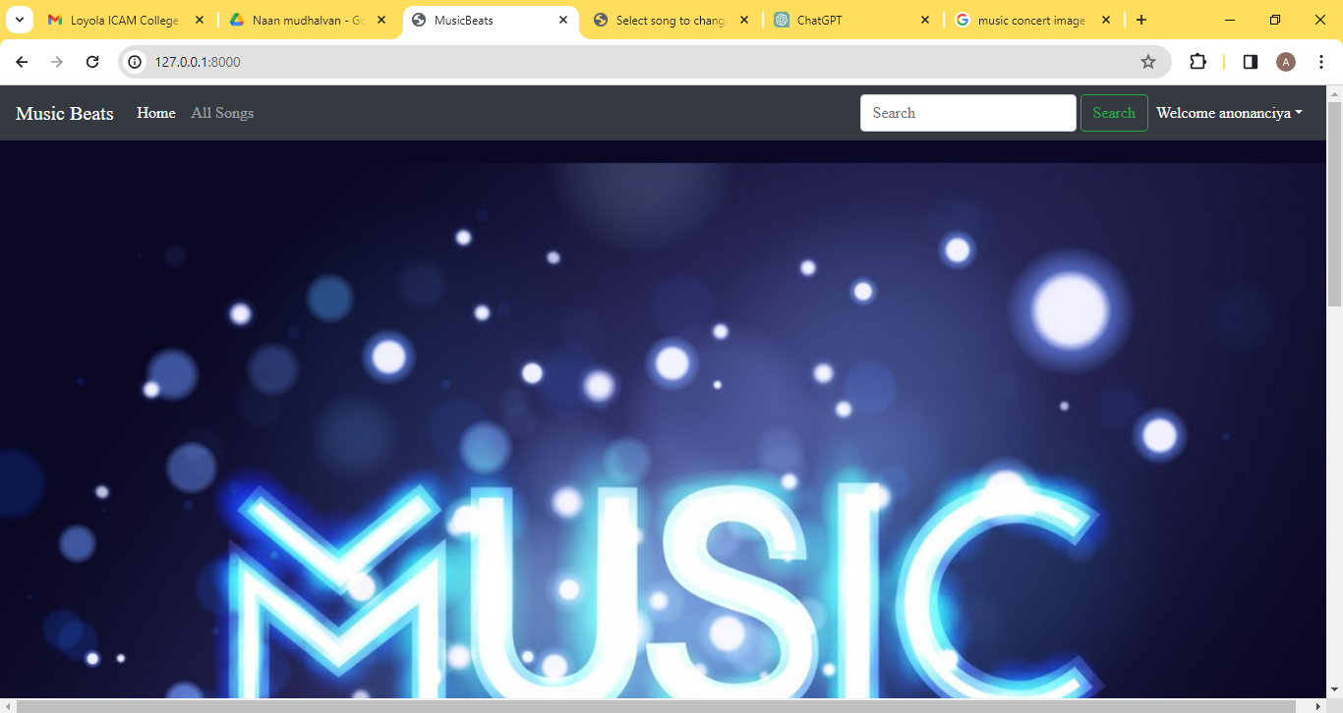
Homepage

Slide 12
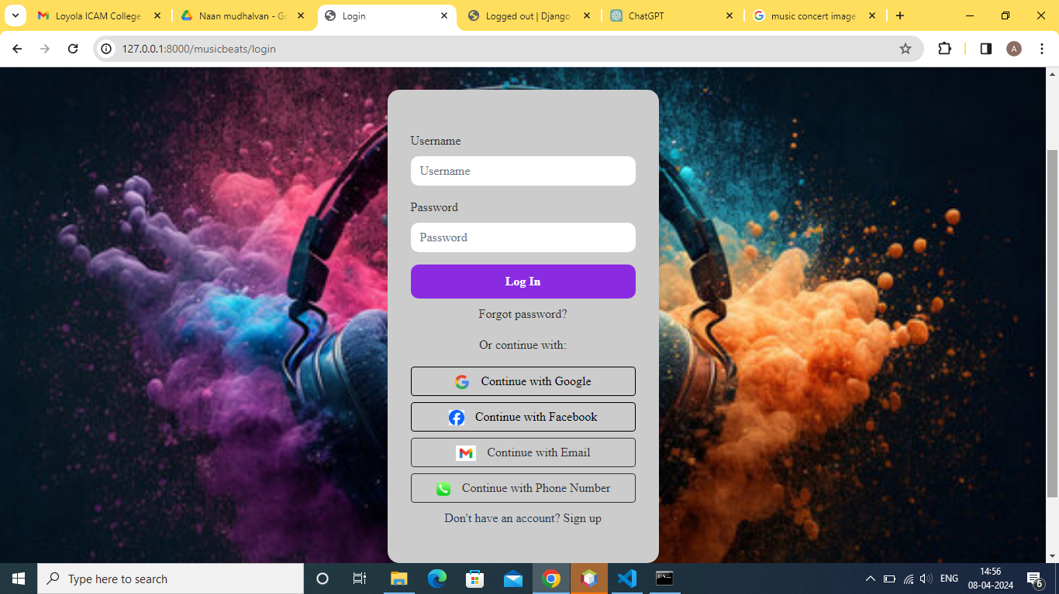
Login Page

Slide 13
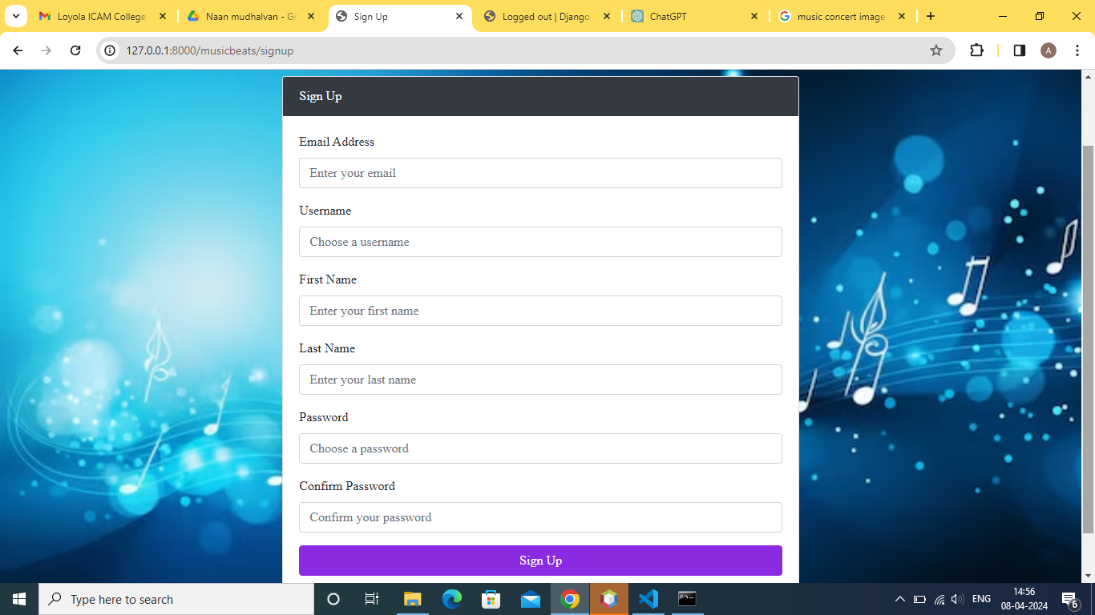
Signup Page

Slide 14
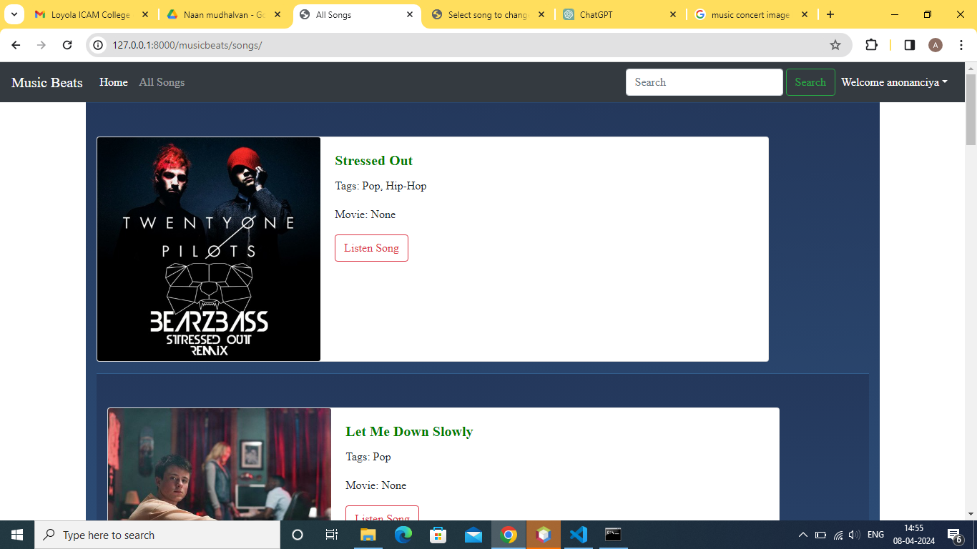
All Songs

Slide 15
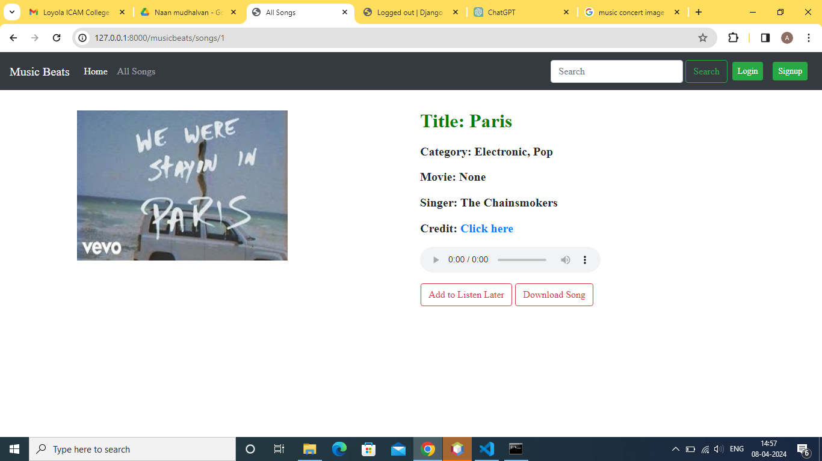

Slide 16
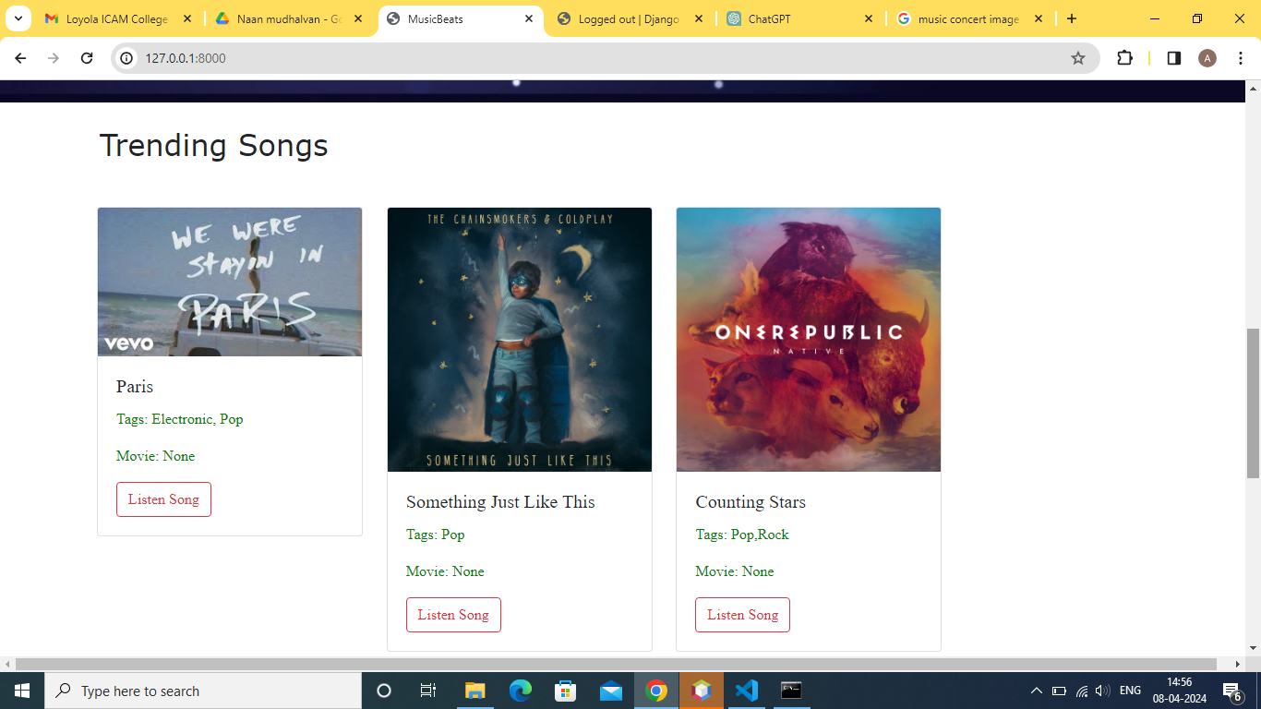
Trending Songs

Slide 17
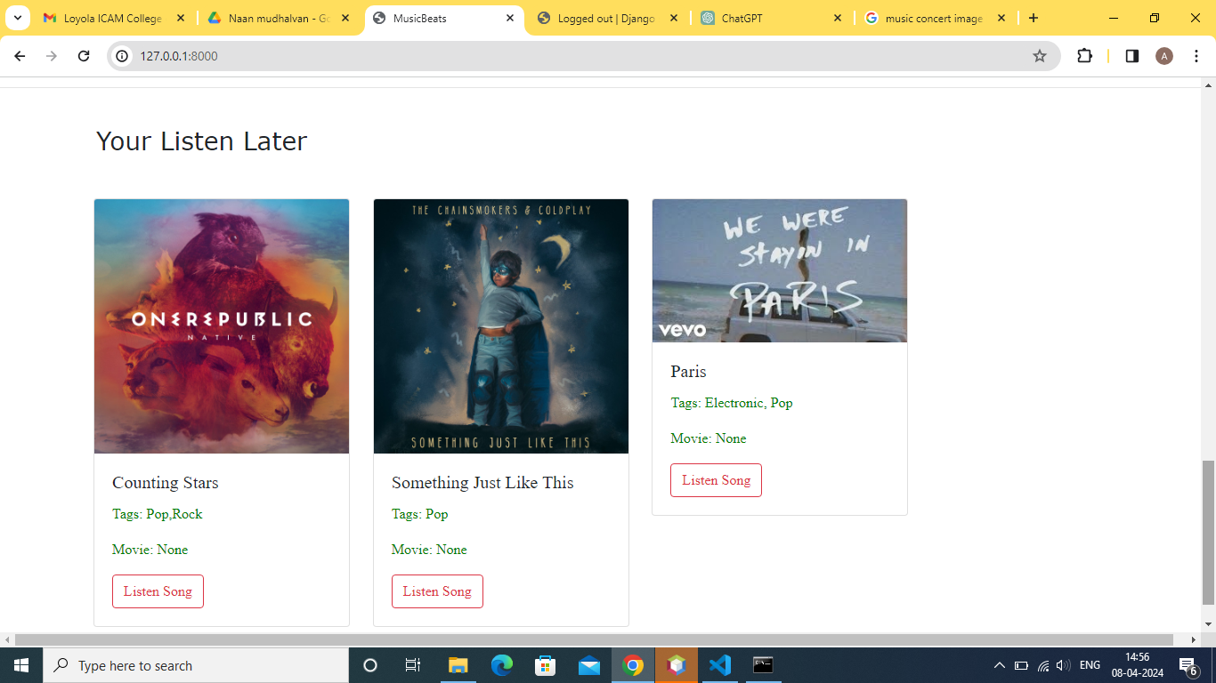
Your Listen Later

Slide 18
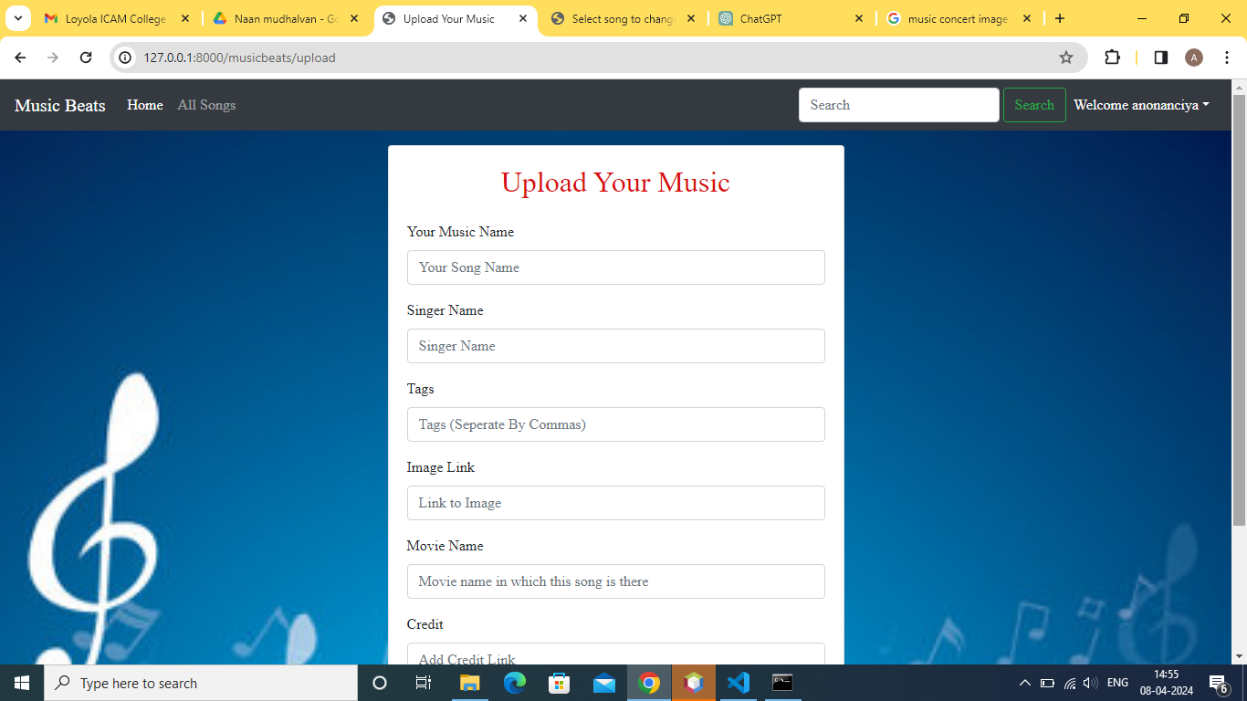
Upload Songs

Slide 19
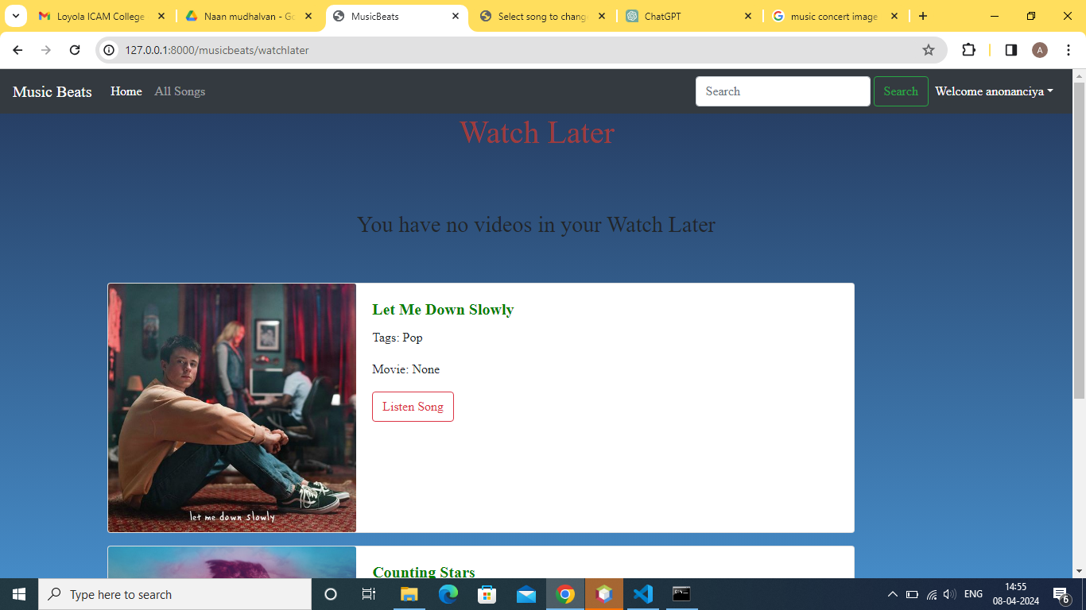
Watch Later

Slide 20
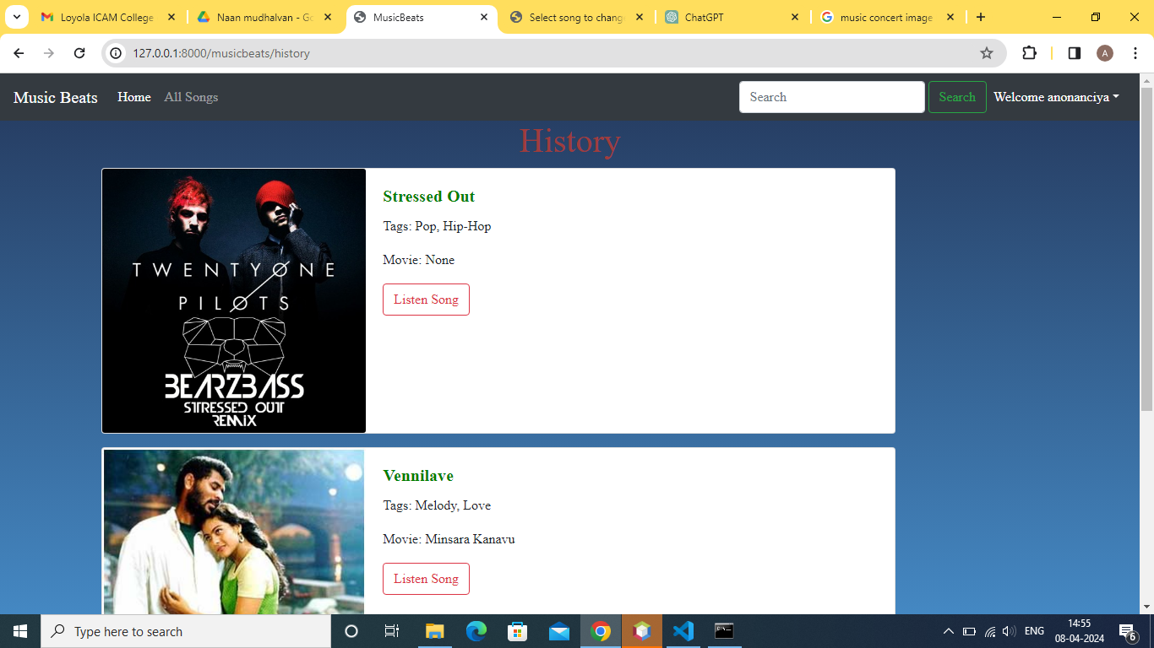
History

Slide 21
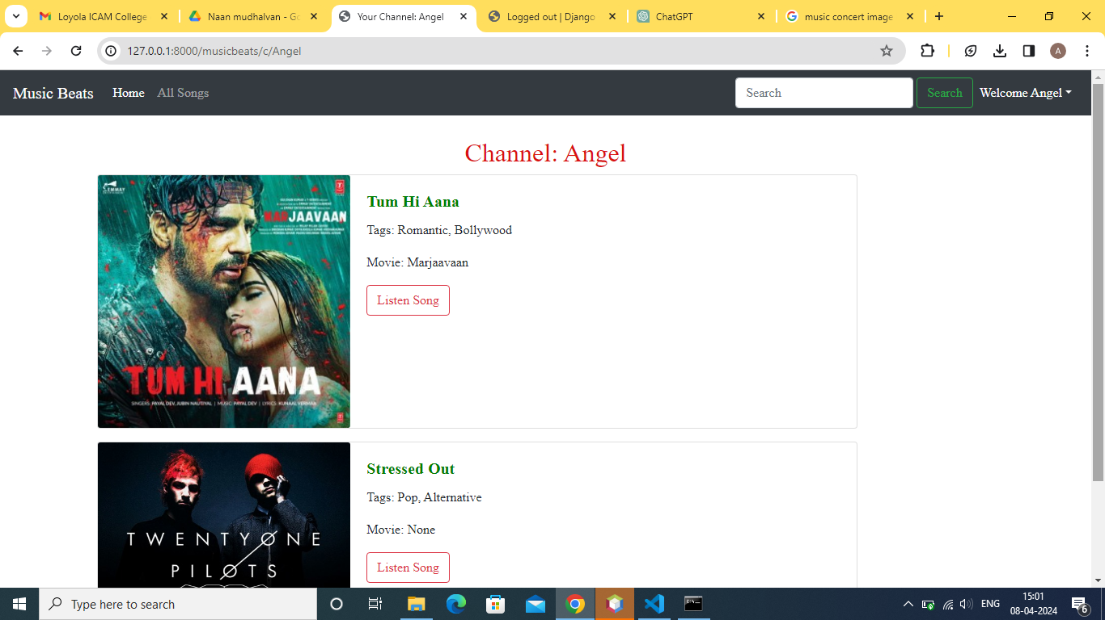
Channel

Slide 22
Future Enhancements:
Social Integration:
Allow users to share playlists, follow other users, and discover music based on their social connections.
Recommendations:
Implement a recommendation system using machine learning to suggest personalized music based on listening habits and preferences.
Offline Mode:
Enable users to download songs or playlists for offline listening, enhancing accessibility and convenience.
Collaborative Playlists:
Introduce collaborative playlist creation, enabling multiple users to contribute and curate playlists together.
.

Slide 23
Live Streaming:
Incorporate live streaming features for music events, concerts, and exclusive performances.
Enhanced User Profiles:
Allow users to personalize their profiles with profile pictures, bios, and music preferences for a more engaging experience.
Music Analysis Tools:
Integrate tools for mood detection and music similarity to enhance content discovery and recommendation accuracy.
Accessibility Features:
Ensure the platform is accessible to users with disabilities by implementing features such as screen reader compatibility and keyboard navigation.
Localization:
Provide support for multiple languages and regions to cater to a global audience and expand the platform's

Slide 24
Conclusion
In conclusion, the Django-based music web application presents a robust platform for users to explore, discover, and enjoy music. Through features like user authentication, extensive music catalog, playlist management, and responsive design, the application offers a seamless and personalized music streaming experience. The implementation of scalability and performance optimization techniques ensures reliable service even under heavy loads. Additionally, future enhancements such as social integration, personalized recommendations, and accessibility features promise to further enrich the user experience and attract a wider audience. Overall, the project demonstrates the potential of Django framework in creating innovative and user-centric web applications, paving the way for continued growth and success in the ever-evolving landscape of online music streaming platforms
Source :

Slide 25
Thank You!
Notes:
Thank You !!

